Slide 1
Tech Tools for Nonprofits
Dennis Deery
dennis@irose.com
http://irose.com

Slide 2
My Philosophy
Get information to come to you
Get community to come to you
Spread your message – whatever it is
Weigh the cost/benefit
Cheap might be better than free
Use the cloud when you can
It’s not me, it’s you

Slide 9
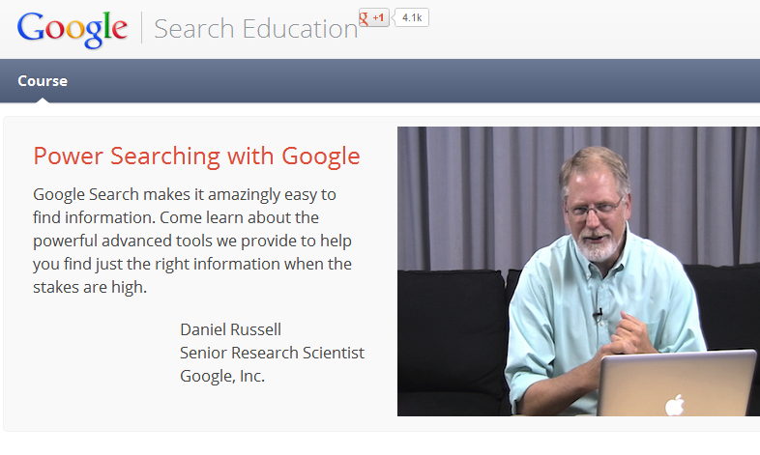

Slide 19
#

Slide 20
Some Twitter Hashtags
#nptech
#ngo
#grants
#grantwriting
#nptalk (Wed, 3-4PM EST)
#smNPchat (Every other Fri, 12-1PM EST)

Slide 23
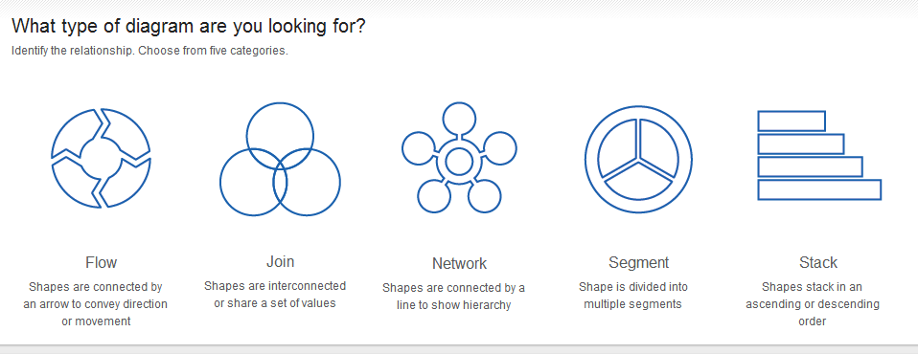
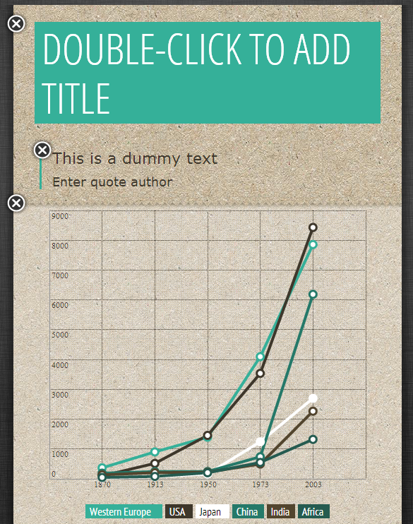

Slide 32
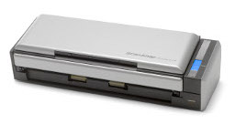
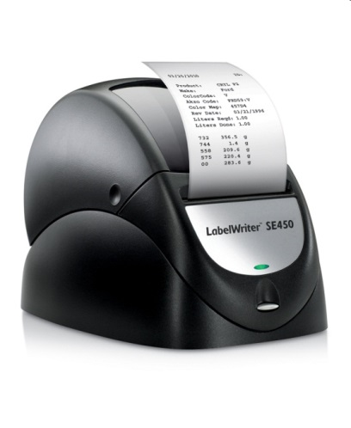
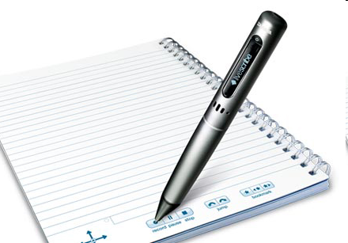
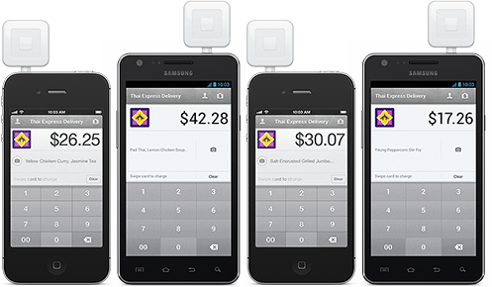

Slide 36
Questions?
irose.com/mnd2013
Connect with me!

