Slide 1
Madison Non-Profit Day
Power Up: Move Your Organization to the Next Level

Slide 2
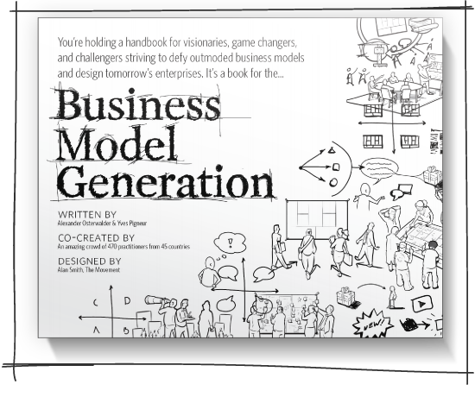
Business Model Generation
http://www.businessmodelgeneration.com/

Slide 3
Business Model Generation
A business model describes the rationale of how an organization creates, delivers and captures value.

Slide 4
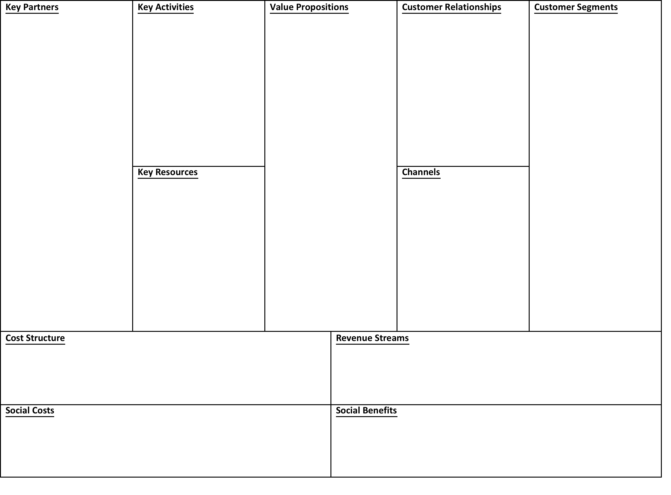
Business Model Generation – The Canvas

Slide 5
Make the investment
Take the time
Seek out help
Get clarity
Take action

Slide 6
Amy Gannon
Assistant Professor
Edgewood College School of Business
Co-Founder
The Doyenne Group
agannon@edgewood.edu

